Slide 1
Rash Driving COD
Sachin
Sunny

Slide 2
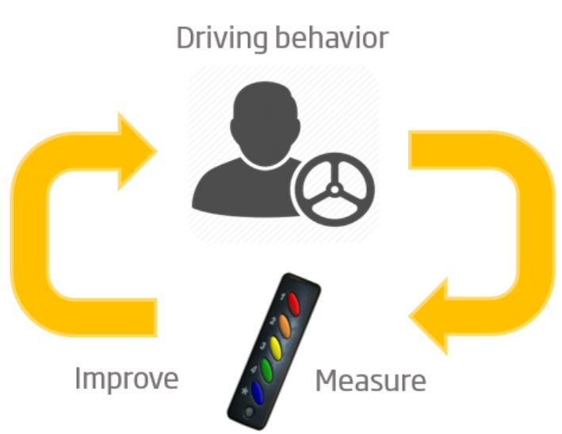
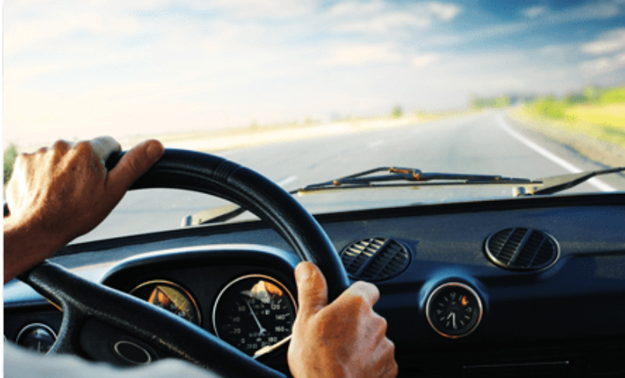
Another use case: Rash driving behaviour profiling
Driver behavior profiling is the process of collecting driving data and applying a computational model to them in order to generate a safety score for the driver.
Notes:
Driver behavior strongly impacts traffic security and causes the vast majority of motor vehicle accidents Driver behavior adaptations might increase overall security and lessen vehicle fuel/energy consumption and gas emissions. In this context, driver behavior profiling tries to better understand and potentially improve driver behavior, leveraging a safer and more energy aware driving.
Driver monitoring and analysis or driver behaviour profiling is the process of collecting driving data (e.g., speed, acceleration, breaking, steering, location) and applying a computational model to them in order to generate a safety score for the driver. However, this information of driver behaviour is sensitive data for various fleet companies like Uber, Ola etc. In this project, we build computational models to study driver behaviour profiling relevance by rewarding drivers with good driving scores while simultaneously preserving the privacy constraints using secure computations.

Slide 3
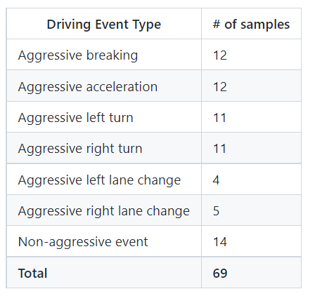
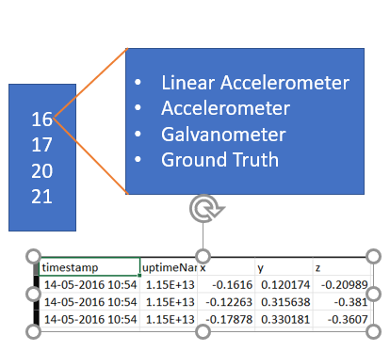
Dataset Used
The dataset is a collection of smartphone sensor measurements for driving events. The experiment was performed in 4 car trips dividing into 7 driving event types.
Dataset: https://github.com/jair-jr/driverBehaviorDataset
Notes:
The dataset is a collection of smartphone sensor measurements for driving events. An Android application is used to record smartphone sensor data, like accelerometer, linear acceleration, magnetometer and gyroscope, while a driver executed particular driving events. The purpose was to establish a set of driving events that represents usual real-world events such as breaking, acceleration, turning, and lane changes. The table shows the 7 driving events types we used in this work and their number of collected samples. The experiment was performed in 4 car trips of approximately 13 minutes each in average.

Slide 4
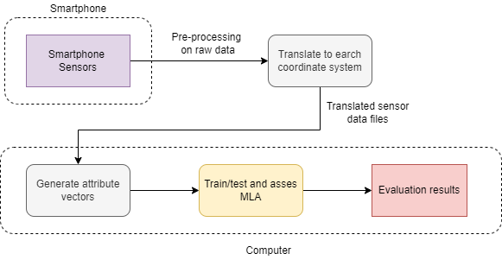
Methodology

Slide 5
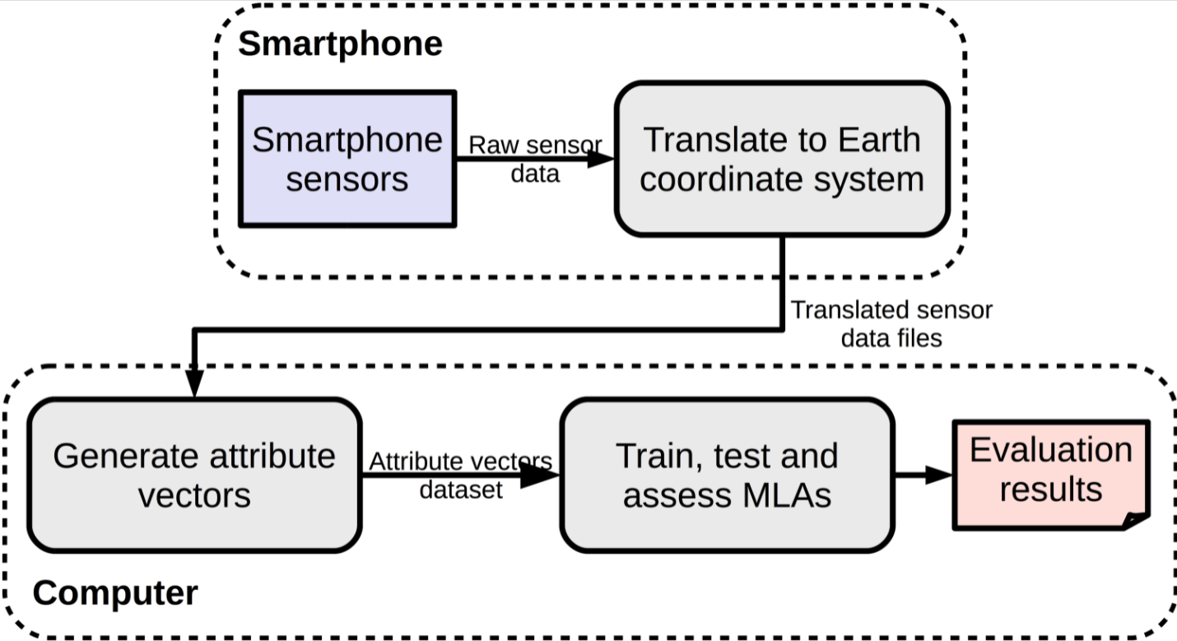
Methodology
Notes:
We modeled this work as a multi-label supervised learning classification problem where the labels are driving events types. The goal of this work is to identify the best combination of motion sensor (and its axes), learning algorithm (and its parameters), and number of frames in the sliding window (nf) to detect individual driving event types. The figure shows a high level view of the evaluation pipeline. In the first step of the pipeline, smartphone sensor raw data is sampled and translated from the device coordinate system to Earth’s coordinate system. This translation is necessary in order to achieve device position independence inside the vehicle. Translated sensor data are then stored in the smartphone file system. In the second step, translated sensor data files are retrieved from the smartphone and used as input to generate attribute vector data sets. In the third step, attribute vector data sets are used to train, test and assess MLAs performances evaluation.

Slide 6
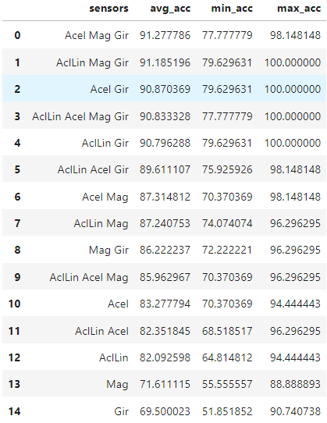
Analysis on Driving dataset
Results: Acel(Acceleration) alone gives the highest accuracy.
Acel & Gir (Acceleration & Gyroscope) combined gives accuracy closest to the highest accuracy
Conclusions: We can use only Acel & Gir sensors to predict the events (less data and high accuracy)

Slide 7
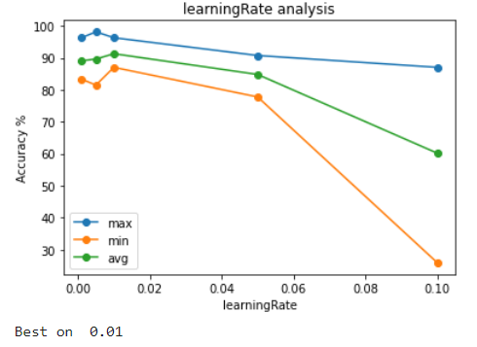
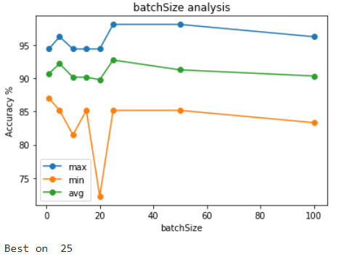
Analysis on Driving dataset

Slide 8
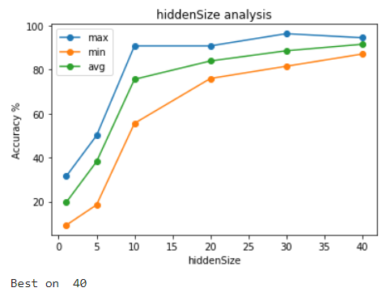
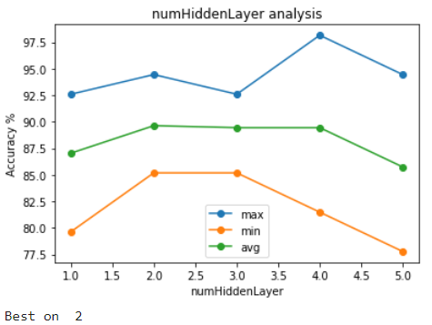
Analysis on Driving dataset

Slide 9
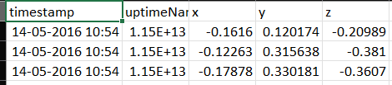
What do we have?
st_accelerometer_nq4
st_accelerometer_nq5
va_accelerometer_nq4
-
-
-
-
Linear Accelerometer
Accelerometer
Galvanometer
Ground Truth
16
17
20
21
p1_p2_p3

Slide 10
Parameters
p1 – data set type
st – time series
va – attribute vector
p2 – sensor
{acelerometro, aceleracaoLinearTerra,campoMagneticoTerra,giroscopioTerra}
p3 – number of frames in skipping window
{4,5,6,7,8}
p1_p2_p3

Slide 11
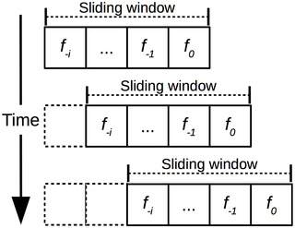

Sliding window

Slide 12
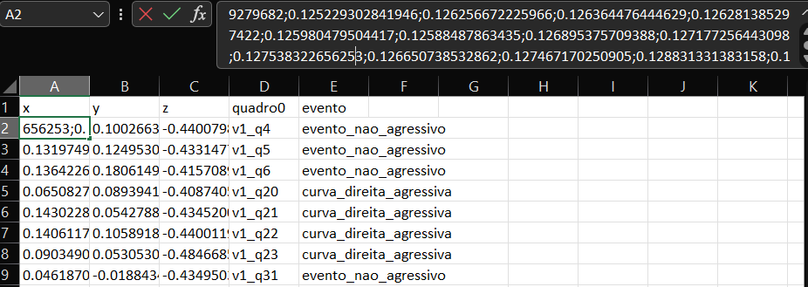
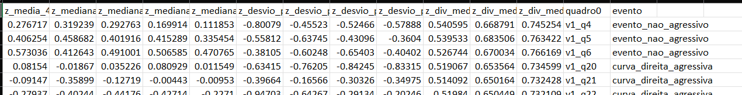
st vs va

Slide 13
Events
Aggressive breaking | freada_agressiva
Aggressive acceleration | aceleracao_agressiva
Aggressive left turn | curva_esquerda_agressiva
Aggressive right turn | curva_direita_agressiva
Aggressive left lane change | troca_faixa_esquerda_agressiva
Aggressive right lane change | troca_faixa_direita_agressiva
Non-aggressive event | evento_nao_agressivo

Slide 14
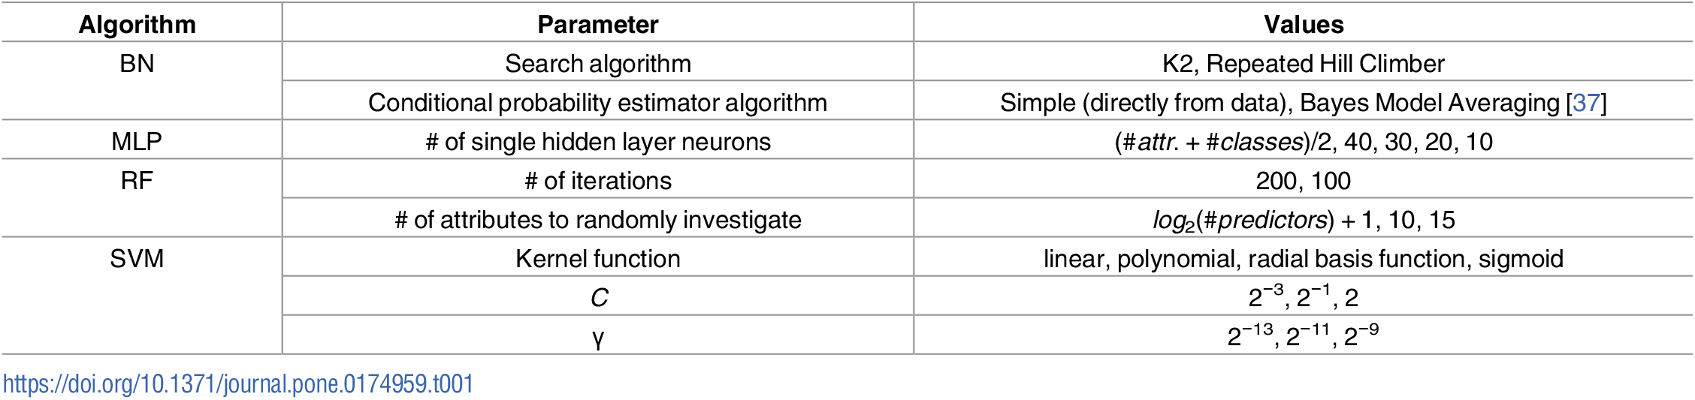
MLA’s

Slide 15
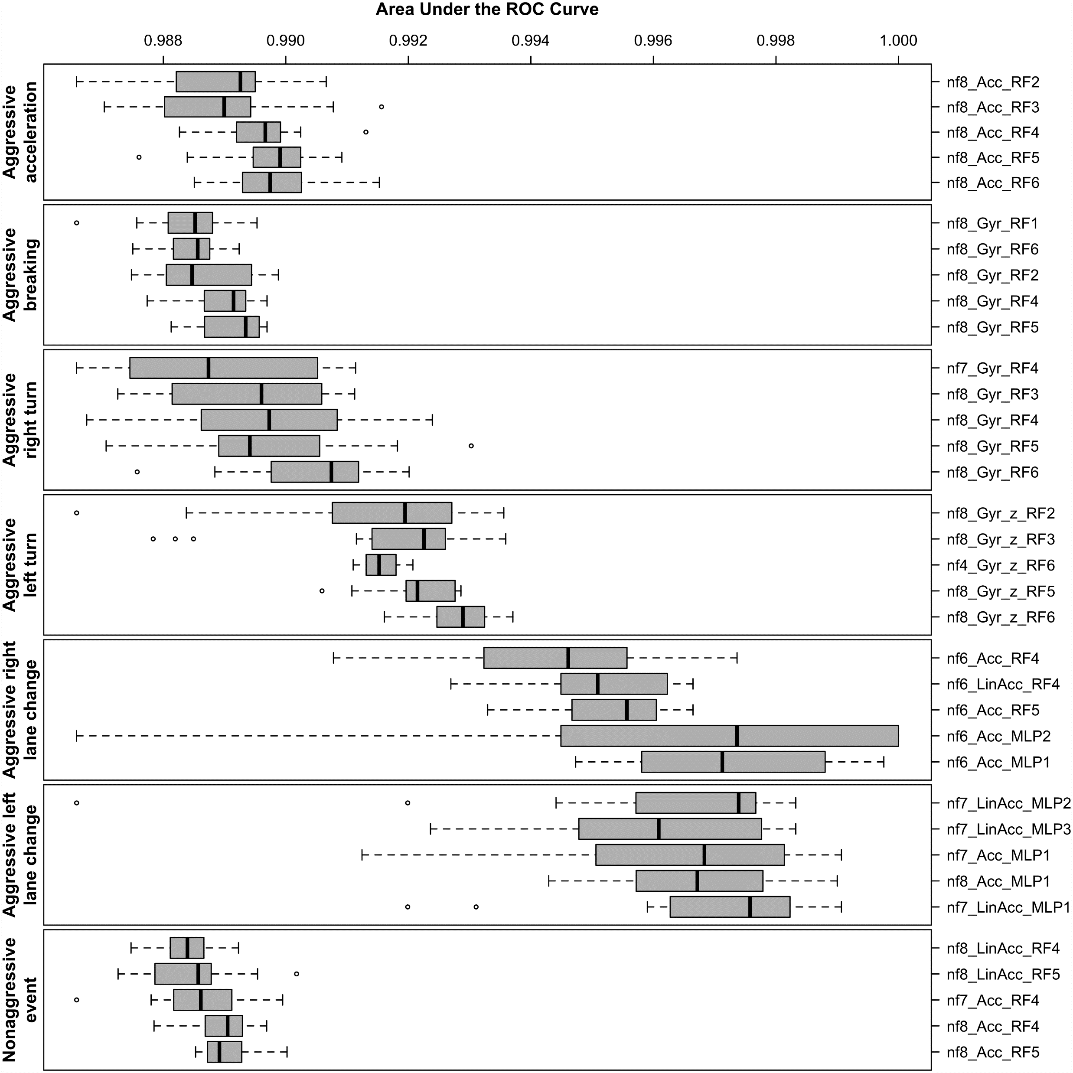
Analysis

Slide 16
Inferences
Firstly, MLAs perform better with higher nf values
Secondly, the gyroscope and the accelerometer are the most suitable sensors to detect the driving events in this experiment. On the other hand, the magnetometer alone is not suitable for event detection as none of the 35 best assemblies use that sensor.
Thirdly, RF is by far the best performing MLA with 28 out of 35 best assemblies.
Fourthly, MLP configuration #1 was the best performing.

